Slide 1
NC Academic Achievement Gaps
By Katharyn Loweth

Slide 2
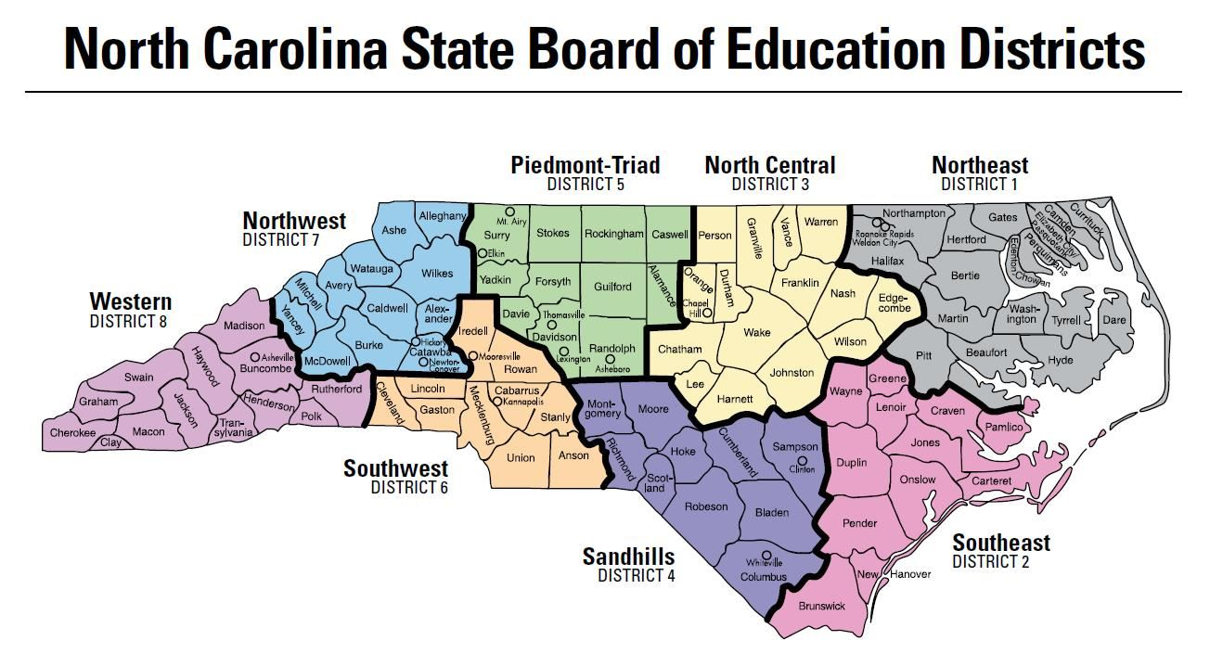
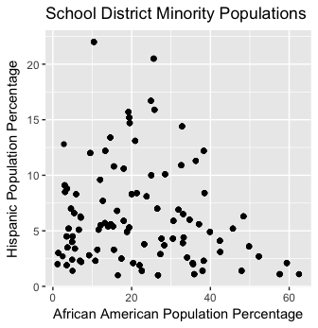
Regions

Slide 3
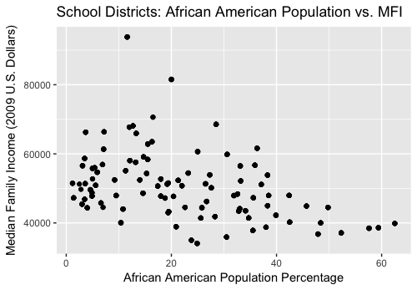
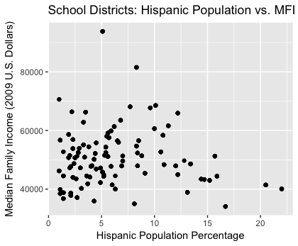
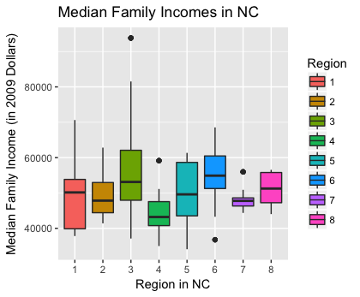
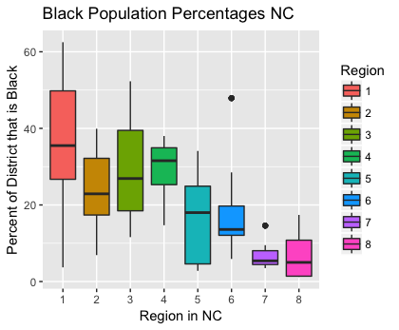
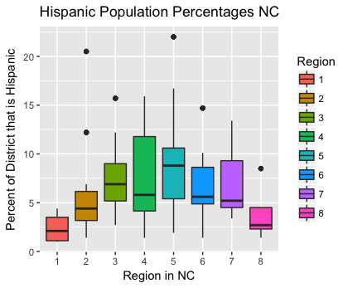
Exploratory Data Analysis

Slide 4
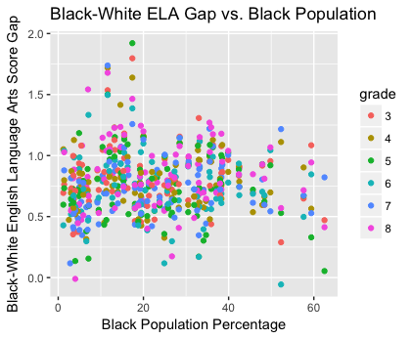
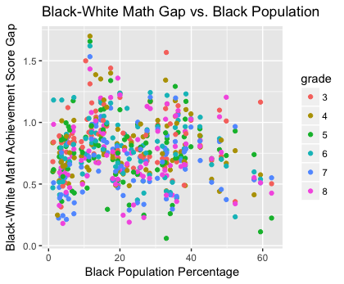
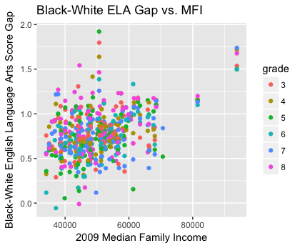
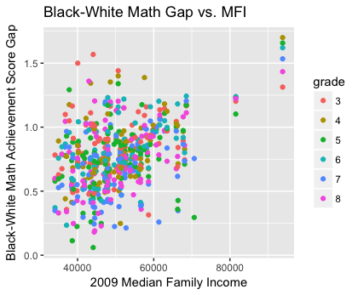
Achievement Gaps-Black Students

Slide 5
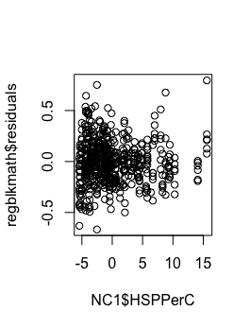
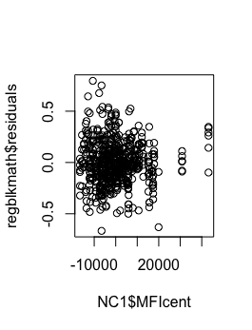
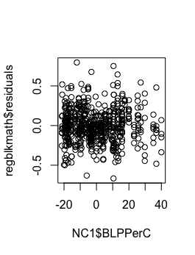
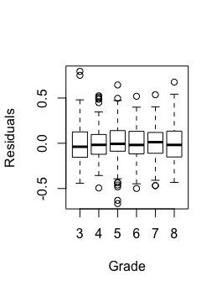
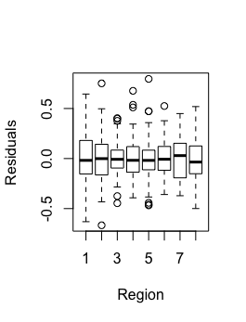
Residual Plots – Gap Black Math

Slide 6
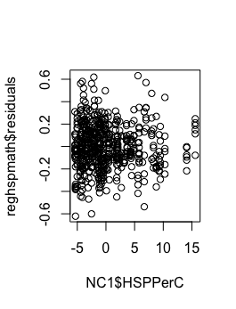
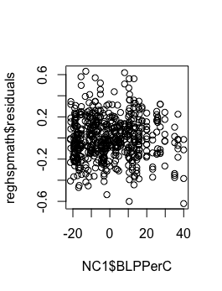
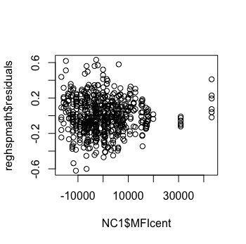
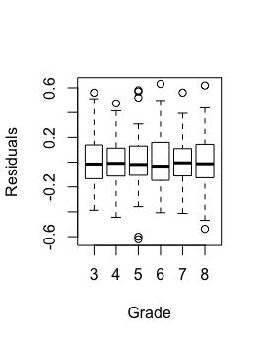
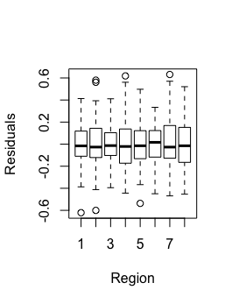
Residual Plots – Hispanic Math Gap

Slide 7
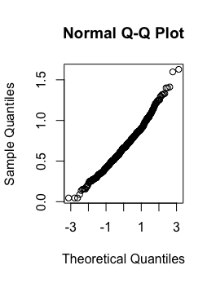
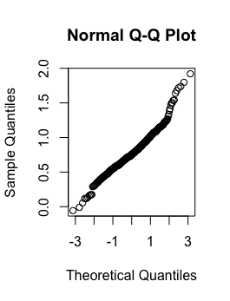
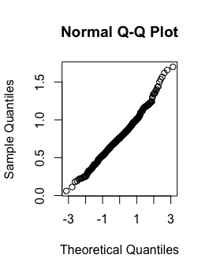
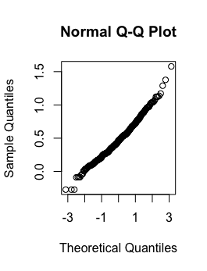
Gapblk_ela
Gaphsp_ela
Gapblk_math
Gaphsp_math

Slide 8
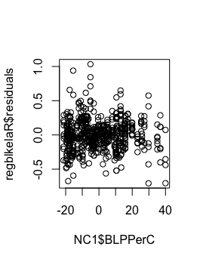
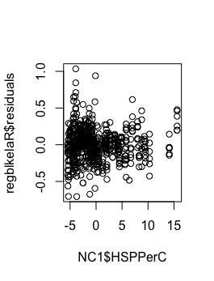
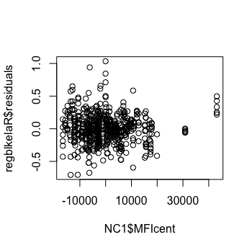
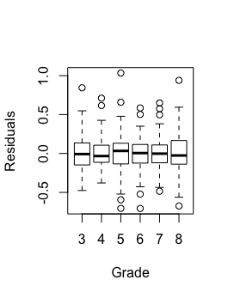
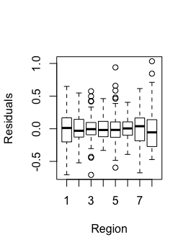
Residual Plots – Black ELA Gap

Slide 9
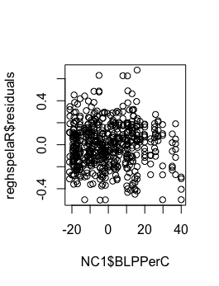
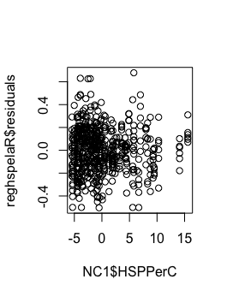
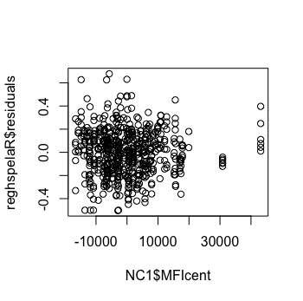
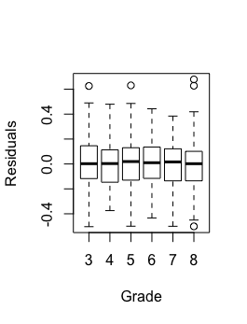
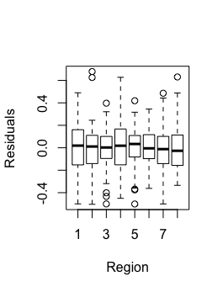
Residual Plots – Hispanic Gap ELA

Slide 10
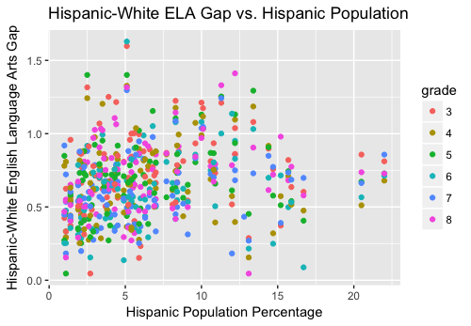
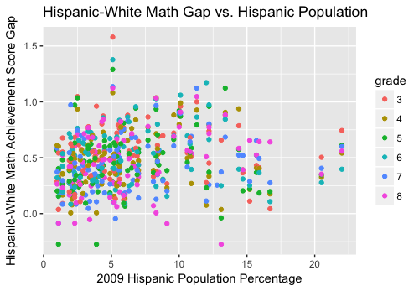
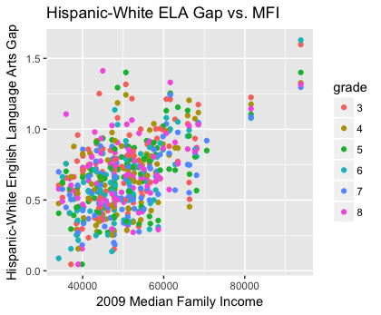
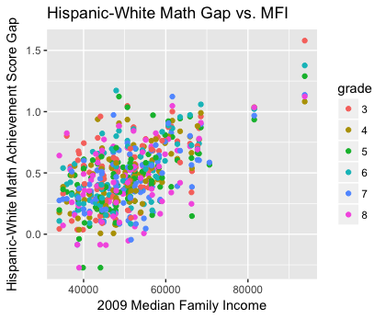
Achievement Gaps—Hispanic Students

Slide 11
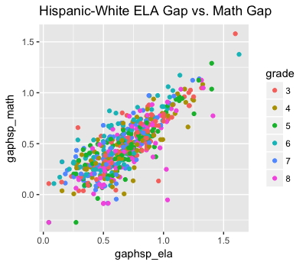
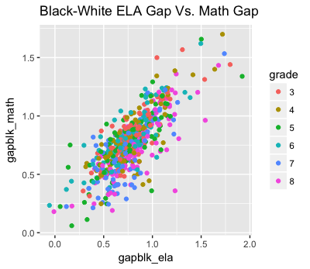
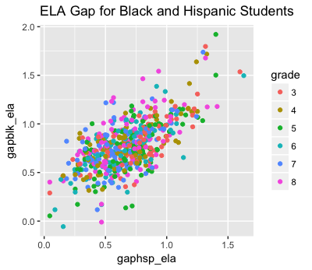
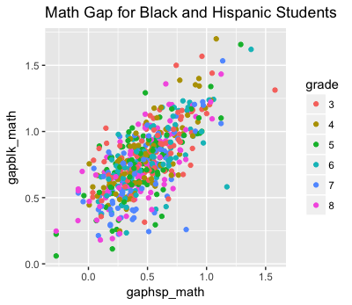

Slide 12
Region and Grade AOV tests
Grade:
Analysis of Variance tests comparing different grade groups for all 4 achievement tests calculated pvalues that were very near zero, suggesting that in the population the gaps change with grade level
It does not reveal if gaps increase over time, just that there is significant evidence that the population mean gaps depending on grade level are not all equal to one another.
Region:
AOV tests comparing region groups’ scores, without separating by grade level as well, calculated pvalues near zero, suggesting differences in region achievements scores in the population holistically.
When comparing by grade level as well (ex. Aov(gapblk_math[grade==3]~Region[grade ==3])), only a few of the tests calculated pvalues less than 0.1. Based on pvalues, region mattered for:
7th Grade Black Math Gap
4th and 5th grade Hispanic ELA Gap
5th and 7th grade Hispanic Math Gap

Slide 13
Questions
Do achievement gaps vary based upon the location of the school district?
What population factors predict achievement gaps?
Do gaps, based on race and academic subject, change as student goes through education system?
Particularly, do they increase over time?
Data Collection
99 School Districts and 561 Data Entries
Academic Achievement Gap Measurements came from the Stanford Education Data Archive
Data shows mean gaps in 2009 academic achievement scores in NC school districts based on grade level, race, and academic subject
School District Population Data came from 2009 American Community Survey

Slide 14
Limitations
Correlations
None of the regression models account for the correlations between the achievement gaps, which limits the fit of the models
 | Gapblk_ela & gapblk-Math | Gapblk_ela & gaphsp_ela | Gaphsp_ela & Gaphsp_math | Gapblk_math & gaphsp_math
Correlation | .78 | .66 | .796 | .696
Hispanic Population Size:
Many school districts had a very small Hispanic Population, which could impact sample achievement gaps
Missing Data:
Because there were several pieces of missing data, there was variation between different ‘mice’ groups, and the significance of different predictor variables. If pvalues seemed significant in this sample but were closer to .1 than 0, it may be that in another mice sample group the predictor was not actually significant, or had less significance.

Slide 15
 | 3rd grade | 4th grade | 5th grade | 6th grade | 7th grade | 8th grade
Mean gapblk_ela (SD) | .81156 (.24) | .7876 (.2424) | .74536 (.2842) | .74075 (.2556) | .7334 (.2411) | .83384 (.2819)
Mean gapblk_math (SD) | .8539 (.2330) | .797 (.2470) | .76277 (.2606) | .80124 (.2426) | .68316 (.25329) | .73018 (.2637)
Mean gaphsp_ela (SD) | .7386 (.2698) | .6756 (.2554) | .6798 (.25886) | .62103 (.26057) | .61105 (.221396) | .69111 (.2499)
Mean gaphsp_math (SD) | .53233 (.2692) | .46634 (.2422) | .4592 (.2641) | .51168 (.26246) | .42623 (.24976) | .44408 (.27209)
Mean Gapblk_ela (SD) | Mean Gapblk_math (SD) | Mean Gaphsp_ela (SD) | Mean Gaphsp_math (SD)
.77514 (.2598) | .77089 (.25516) | .66941 (.2555) | .47292 (.26157)
Grade | # of Entries
3 | 93
4 | 94
5 | 95
6 | 91
7 | 96
8 | 92
Region | # of Entries
1 | 82
2 | 72
3 | 96
4 | 72
5 | 83
6 | 72
7 | 47
8 | 37
 | BLPPer | HSPPer | MFI
Min | 1.20 | 1 | 33089
1st Quarter | 10.80 | 3 | 44110
Median | 20.00 | 5.3 | 49607
Mean | 22.51 | 6.414 | 50694
3rd Quarter | 33.10 | 8.4 | 55960
Max | 62.50 | 22 | 93831
SD | 14.49446 | 4.5 | 9898.4

Slide 16
Missing Data
In Stanford’s Education Data Archive, some school districts did not report achievement gaps for particular racial groups.
Ex. School district would report data for African American Students, but not for Hispanic Students
Solution: Used MICE R package to fill in for missing data
Regression Models
Centered continuous predictors MLP, BLPPer, and HSPPer
Created Interactions between MFI and BLPPer, and MFI and HSPPer
Made Dummy Variables for the categorical variables Region and Grade
Multilinear Regression Assumptions:
Each of the QQnorm plots of the dependent variables show a straight line -> data follows a normal distribution
Due to large sample size, I’m going to assume equal variance
Each data entry is independent

Slide 17
Definitions
Gapblk_ela = Mean Gap in English and Language Arts Achievement Scores between Black and White Students
Gapblk_math = Mean Gap in Mathematic Achievement Scores between Black and White Students
Gaphsp_ela = Mean Gap in English and Language Arts Achievement Scores between White and Hispanic Students
Gaphsp_math = Mean Gap in Mathematics Achievement Scores between White and Hispanic Students
BLPPer: Percentage of School District Population that identifies as solely African American
HSPPer: Percentage of School District Population that identifies as Hispanic
MFI: Median Family Income in 2009 Dollars
Grade: Grade Level of Students (3-8)
Region: Geographical Region School District is in based on map pictured (1-8)

Slide 18
Black ELA:
regblkela = lm(gapblk_ela~MFIcent + as.factor(grade) + as.factor(Region) + BLPPerC + HSPPerC, data = NC1)
This model does not include any interactions or transformations. I initially included interactions in the regression, but the nested F test calculated that they were not useful predictors for this sample, and to make prediction simpler, I took them out. I did not see any evidence for a transformation.
Residual plots using the model look good.

Slide 19
Coefficients:
Estimate Std. Error t value Pr(>|t|)
(Intercept) 7.934e-01 3.602e-02 22.027 < 2e-16 ***
MFIcent 1.436e-05 1.305e-06 11.004 < 2e-16 ***
BLPPerC 5.752e-03 1.067e-03 5.389 1.06e-07 ***
HSPPerC 8.140e-03 2.416e-03 3.369 0.000808 ***
as.factor(grade)4 -2.547e-02 3.307e-02 -0.770 0.441599
as.factor(grade)5 -6.588e-02 3.298e-02 -1.998 0.046237 *
as.factor(grade)6 -6.808e-02 3.334e-02 -2.042 0.041619 *
as.factor(grade)7 -7.680e-02 3.290e-02 -2.335 0.019929 *
as.factor(grade)8 2.728e-02 3.325e-02 0.821 0.412245
as.factor(Region)2 2.062e-02 3.917e-02 0.526 0.598844
as.factor(Region)3 -2.118e-02 3.728e-02 -0.568 0.570139
as.factor(Region)4 1.900e-02 3.978e-02 0.478 0.633128
as.factor(Region)5 -3.940e-02 4.295e-02 -0.917 0.359339
as.factor(Region)6 1.842e-02 4.054e-02 0.454 0.649697
as.factor(Region)7 5.061e-02 5.184e-02 0.976 0.329345
as.factor(Region)8 2.215e-01 5.339e-02 4.149 3.87e-05 ***
---
Signif. codes: 0 ‘***’ 0.001 ‘**’ 0.01 ‘*’ 0.05 ‘.’ 0.1 ‘ ’ 1
Residual standard error: 0.2261 on 545 degrees of freedom
Multiple R-squared: 0.2634, Adjusted R-squared: 0.2431
F-statistic: 12.99 on 15 and 545 DF, p-value: < 2.2e-16
2.5 % 97.5 %
7.226732e-01 8.641830e-01
1.179439e-05 1.692016e-05
3.655101e-03 7.848585e-03
3.394203e-03 1.288671e-02
-9.043672e-02 3.949912e-02
-1.306650e-01 -1.103160e-03
-1.335744e-01 -2.594100e-03
-1.414166e-01 -1.217901e-02
-3.802570e-02 9.258867e-02
-5.632874e-02 9.756770e-02
-9.440459e-02 5.204366e-02
-5.914615e-02 9.714643e-02
-1.237582e-01 4.496122e-02
-6.121038e-02 9.805558e-02
-5.121962e-02 1.524446e-01
1.166473e-01 3.263822e-01

Slide 20
Interpretation
Black ELA:
The intercept .7934 (95% CI: .72267, .86418) interprets as the predicted mean score gap between Black and White students on a 3rd grade English Language Arts Achievement test, given that the school district has average Median Family Income, is in region 1, and has average Black and Hispanic populations. The intercept’s pvalue suggests overwhelming evidence that the population mean gap is not equal to zero.
In the regression summary, variables MFIcent, BLPPerC, and HSPPerC all have pvalues less than .001, suggesting that these predictors are significant to the prediction and have an effect on the mean score gap in the population. If MFIcent, BLPPerC, or HSPPerC were to increase by one unit, it would cause the score gap to increase by .1.436e-05 (95%CI: 1.179e-05, 1.692e-05), 5.752e-03 (95%CI: 3.655e-03, 7.848e-03), or 8.14e-03 (95%CI: 3.3942e-03, 1.2887e-02), respectively.
Compared to the baseline, based on pvalues, being in Region 8 or in grades 5, 6, or 7 also seem to be significant to the mean score gap. If the test were administered to students in grades 5, 6, or 7, the gap would have decreased by .6588e-02 (95%CI: -1.31 e-01, -1.103e-03), .6808e-02 (95%CI: -.1336, -2.59e-03), or .7680e-02 (95%CI: -.1414, -1.218e-02). If the school district were in Region 8, the gap would increase by .2215 (95%CI: .1166, .32638).

Slide 21
Black Math:
regblkmath = lm(gapblk_math~MFIcent + MFIBLP + BLPPerC2 + MFIHSP+ as.factor(grade) + as.factor(Region) + BLPPerC + HSPPerC, data = NC1)
For this regression model, I included a quadratic term of BLPPerC because the scatterplot of gapblk_math vs. BLPPer looked like it need a transformation. I included both interactions MFIBLP and MFIHSP because in the scatterplots there were negative correlations between MFI and BLPPer or HSPPer.
Residual Plots using the model look good.

Slide 22
Coefficients:
Estimate Std. Error t value Pr(>|t|)
(Intercept) 8.480e-01 3.723e-02 22.777 < 2e-16 ***
MFIcent 1.287e-05 1.316e-06 9.785 < 2e-16 ***
MFIBLP -2.668e-07 1.108e-07 -2.408 0.016379 *
BLPPerC2 -2.407e-04 5.828e-05 -4.131 4.19e-05 ***
MFIHSP 2.057e-07 2.843e-07 0.724 0.469573
as.factor(grade)4 -5.842e-02 3.139e-02 -1.861 0.063251 .
as.factor(grade)5 -9.032e-02 3.129e-02 -2.886 0.004055 **
as.factor(grade)6 -5.229e-02 3.164e-02 -1.653 0.098977 .
as.factor(grade)7 -1.691e-01 3.122e-02 -5.416 9.18e-08 ***
as.factor(grade)8 -1.204e-01 3.155e-02 -3.815 0.000152 ***
as.factor(Region)2 1.631e-02 3.824e-02 0.426 0.669942
as.factor(Region)3 3.250e-03 3.703e-02 0.088 0.930097
as.factor(Region)4 1.265e-02 4.027e-02 0.314 0.753637
as.factor(Region)5 2.341e-02 4.130e-02 0.567 0.571025
as.factor(Region)6 5.439e-02 4.046e-02 1.344 0.179351
as.factor(Region)7 1.457e-01 5.227e-02 2.788 0.005483 **
as.factor(Region)8 2.005e-01 5.255e-02 3.815 0.000152 ***
BLPPerC 6.279e-03 1.137e-03 5.523 5.19e-08 ***
HSPPerC 9.577e-03 2.726e-03 3.513 0.000479 ***
---
Signif. codes: 0 ‘***’ 0.001 ‘**’ 0.01 ‘*’ 0.05 ‘.’ 0.1 ‘ ’ 1
Residual standard error: 0.2145 on 542 degrees of freedom
Multiple R-squared: 0.316, Adjusted R-squared: 0.2933
F-statistic: 13.91 on 18 and 542 DF, p-value: < 2.2e-16
2.5 % 97.5 %
7.749060e-01 9.211815e-01
1.028985e-05 1.545922e-05
-4.844750e-07 -4.914575e-08
-3.552224e-04 -1.262527e-04
-3.526665e-07 7.640881e-07
-1.200689e-01 3.236067e-03
-1.517965e-01 -2.884868e-02
-1.144442e-01 9.861720e-03
-2.303807e-01 -1.077432e-01
-1.823466e-01 -5.839806e-02
-5.881123e-02 9.142820e-02
-6.949016e-02 7.598997e-02
-6.646479e-02 9.175689e-02
-5.771691e-02 1.045433e-01
-2.507683e-02 1.338622e-01
4.306939e-02 2.484114e-01
9.724170e-02 3.037114e-01
4.045616e-03 8.512429e-03
4.222467e-03 1.493174e-02

Slide 23
Black Math
The intercept .848 (95% CI: .7749, .92118) signifies the mean gap in math achievement scores between black and white students in the 3rd grade who live in a school district in region 1 whose population has average median family income, and average black and Hispanic population percentages. Based on the pvalue of 2e-16, there is overwhelming evidence that the gap exists within the population.
Based on pvalues, population characteristics MFIcent, MFIBLP, BLPPerC2, BLPPerC, HSPPerC seem to be significant to the prediction of the black math gap in the school district. If MFI were to increase by one unit, it would increase the mean score gap by 1.287e-05 (95%CI: 1.029e-05, 1.5459e-05) and then decrease it by 2.688e-07 (95%CI: -4.8447e-07, -4.9156e-08). If average BLPPer were to increase by one unit, it would increase the score gap by .6279e-03 (95%CI: 4.046e-03, 8.512e-03) and then decrease by 2.688e-07 (95%CI: -4.8447e-07, -4.9156e-08) and 2.407e-04 (-3.5522e-04, -1.262e-04). If you were to increase HSPPerC by one unit, you would add 9.577e-03 (95%CI: 4.222e-03, 1.49e-02) to the score gap.
For the baseline, based on pvalues, being in grades 5, 7 or 8 or in Region 7 and 8 are significant predictors of the math score gap between black and white students. If the student were in grades 5, 7, or 8, the score gap would be decreased by 9.032e-02 (95%CI: -5.772e-02, 1.04e-01), .1691 (95%CI: -.23, -.1077), or .1204 (95%CI: -.1823, -.05839). If the school district were in Region 7 or 8, the gap would increase by .1457 (95%CI: 4.307e-02, .2484) or .2005 (95%CI: 9.724e-02, .3037), respectively.

Slide 24
Hispanic ELA:
reghspelaR = lm(gaphsp_ela~MFIcent + MFIHSP + as.factor(grade) + as.factor(Region) + BLPPerC + HSPPerC, data = NC1)
In the model I included all of the original predictors plus the interaction MFIHSP because of the negative correlation between MFI and HSPPer. I initially included interaction MFIBLP and quadratic term HSPPerC2, but a nested F test calculated that these were not useful predictors for this sample and to make prediction simpler I took them out.
The residual plots using the model look good.

Slide 25
Coefficients:
Estimate Std. Error t value Pr(>|t|)
(Intercept) 6.950e-01 3.226e-02 21.543 < 2e-16 ***
MFIcent 1.719e-05 1.156e-06 14.873 < 2e-16 ***
MFIHSP 5.193e-07 2.601e-07 1.997 0.04637 *
as.factor(grade)4 -6.545e-02 2.901e-02 -2.256 0.02444 *
as.factor(grade)5 -5.826e-02 2.892e-02 -2.014 0.04447 *
as.factor(grade)6 -1.167e-01 2.924e-02 -3.993 7.43e-05 ***
as.factor(grade)7 -1.273e-01 2.885e-02 -4.411 1.24e-05 ***
as.factor(grade)8 -4.295e-02 2.916e-02 -1.473 0.14133
as.factor(Region)2 3.675e-02 3.442e-02 1.068 0.28615
as.factor(Region)3 5.816e-03 3.389e-02 0.172 0.86381
as.factor(Region)4 6.955e-02 3.527e-02 1.972 0.04914 *
as.factor(Region)5 3.077e-02 3.797e-02 0.810 0.41813
as.factor(Region)6 -3.512e-03 3.708e-02 -0.095 0.92458
as.factor(Region)7 1.263e-01 4.708e-02 2.683 0.00752 **
as.factor(Region)8 2.201e-01 4.776e-02 4.608 5.07e-06 ***
BLPPerC 3.875e-03 9.840e-04 3.938 9.29e-05 ***
HSPPerC 1.698e-02 2.476e-03 6.857 1.91e-11 ***
---
Signif. codes: 0 ‘***’ 0.001 ‘**’ 0.01 ‘*’ 0.05 ‘.’ 0.1 ‘ ’ 1
Residual standard error: 0.1982 on 544 degrees of freedom
Multiple R-squared: 0.4152, Adjusted R-squared: 0.398
F-statistic: 24.14 on 16 and 544 DF, p-value: < 2.2e-16
2.5 % 97.5 %
6.315861e-01 7.583235e-01
1.492249e-05 1.946394e-05
8.388996e-09 1.030120e-06
-1.224242e-01 -8.471238e-03
-1.150742e-01 -1.445716e-03
-1.741829e-01 -5.931147e-02
-1.839213e-01 -7.058033e-02
-1.002236e-01 1.432560e-02
-3.086046e-02 1.043513e-01
-6.076119e-02 7.239375e-02
2.638248e-04 1.388430e-01
-4.381912e-02 1.053521e-01
-7.634646e-02 6.932290e-02
3.383289e-02 2.187924e-01
1.262557e-01 3.138850e-01
1.942042e-03 5.807851e-03
1.211598e-02 2.184428e-02

Slide 26
Hispanic ELA:
The intercept .6950 interprets as the mean score gap between White and Hispanic Students on a Third Grade English Language Arts Achievement Test in a school district in Region 1 whose population has an average median family income and average Black and Hispanic population percentages. Its pvalue is very small, strongly suggesting that the score gap is not equal to zero in the population.
In the regression model, based on very small pvalues, there is significant evidence that the continuous predictors BLPPerC, HSPPerC, MFIcent and interaction MFIHSP are not equal to zero in the population and are useful predictors for this sample. If the black population percentage were to increase by one, it would increase the score gap by 3.875e-03 (95%CI: 1.942e-03, 5.8079e-03). If the Hispanic population percentage were to increase by one, it would increase the score gap by 1.698e-02 (95%CI: 1.2116e-02, 2.1844e-02) and 5.193e-07 (95%CI: 8.389e-09, 1.03e-06). If the MFI were to increase by one unit, it would increase the score gap by 1.719e-05 (95%CI: 1.492e-05, 1.94e-05) and 5.193e-07 (95%CI: 8.389e-09, 1.03e-06).
For this baseline, based on pvalues, grades 6 and 7 and Regions 7 and 8 can be useful predictors for determining the score gap. If the students were in grades 6 or 7, the score gap would decrease by .1167 (95%CI: -.17418, -5.93e-02) or .1273 (95%CI: -.1839, -7.058e-02), respectively. If the school district were in Region 7 or 8, the score gap would increase by .1263 (95%CI: 3.383e-02, .21879) or .2201 (95%CI: .12626, .31386), respectively.

Slide 27
Hispanic Math:
reghspmath = lm(gaphsp_math~MFIcent + MFIBLP + MFIHSP + HSPPerC2 + as.factor(grade) + as.factor(Region) + BLPPerC + HSPPerC, data = NC1)
In the regression model, I included the quadratic transformation HSPPerC2 because the plot had slight parabolic shape, and the interaction terms because of negative correlations between MFI and BLPPer and HSPPer.
The residual plots using the model look good.

Slide 28
Coefficients:
Estimate Std. Error t value Pr(>|t|)
(Intercept) 4.477e-01 3.635e-02 12.319 < 2e-16 ***
MFIcent 1.899e-05 1.232e-06 15.416 < 2e-16 ***
MFIBLP 9.608e-08 8.036e-08 1.196 0.232392
MFIHSP 6.898e-07 2.900e-07 2.379 0.017719 *
HSPPerC2 7.169e-04 4.120e-04 1.740 0.082439 .
as.factor(grade)4 -6.719e-02 2.943e-02 -2.283 0.022806 *
as.factor(grade)5 -7.305e-02 2.934e-02 -2.489 0.013097 *
as.factor(grade)6 -1.977e-02 2.967e-02 -0.666 0.505496
as.factor(grade)7 -1.061e-01 2.927e-02 -3.625 0.000316 ***
as.factor(grade)8 -8.508e-02 2.958e-02 -2.876 0.004184 **
as.factor(Region)2 3.717e-02 3.552e-02 1.047 0.295743
as.factor(Region)3 5.563e-02 3.543e-02 1.570 0.117011
as.factor(Region)4 8.886e-02 3.725e-02 2.386 0.017388 *
as.factor(Region)5 8.735e-02 3.955e-02 2.208 0.027639 *
as.factor(Region)6 8.634e-02 3.821e-02 2.260 0.024238 *
as.factor(Region)7 1.638e-01 4.897e-02 3.346 0.000878 ***
as.factor(Region)8 1.959e-01 4.859e-02 4.032 6.32e-05 ***
BLPPerC 5.325e-03 1.038e-03 5.128 4.08e-07 ***
HSPPerC 9.914e-03 3.274e-03 3.028 0.002578 **
---
Signif. codes: 0 ‘***’ 0.001 ‘**’ 0.01 ‘*’ 0.05 ‘.’ 0.1 ‘ ’ 1
Residual standard error: 0.2011 on 542 degrees of freedom
Multiple R-squared: 0.4277, Adjusted R-squared: 0.4087
F-statistic: 22.51 on 18 and 542 DF, p-value: < 2.2e-16
2.5 % 97.5 %
3.763348e-01 5.191255e-01
1.656606e-05 2.140450e-05
-6.178249e-08 2.539402e-07
1.201558e-07 1.259430e-06
-9.246869e-05 1.526285e-03
-1.249961e-01 -9.382706e-03
-1.306885e-01 -1.540477e-02
-7.804544e-02 3.850972e-02
-1.635968e-01 -4.860492e-02
-1.431944e-01 -2.697266e-02
-3.259656e-02 1.069452e-01
-1.397548e-02 1.252364e-01
1.569516e-02 1.620298e-01
9.650460e-03 1.650434e-01
1.128369e-02 1.613957e-01
6.763942e-02 2.600316e-01
1.004755e-01 2.913648e-01
3.285061e-03 7.364201e-03
3.482506e-03 1.634459e-02

Slide 29
Hispanic Math:
The intercept .4477 (95%CI: .37633, .5191) interprets as the mean score gap between White and Hispanic students in the third grade on a math achievement test. The school district the students are in has average median family income, is in region 1, and have average Black and Hispanic population percentages.
The regression summary shows that population characteristics BLPPerC, HSPPerC, MFIcent, and interaction MFIHSP are significant predictors for the mean score gap because the pvalues for these variables are all below .02. If the Black population percentage were to increase by one, the score gap would increase by 5.325e-03 (95%CI: 3.285e-03, 7.364e-03). If the Hispanic population percentage were to increase by one, the score gap would increase by 9.914e-03 (95%CI: 3.4825e-03, 1.634e-02) and 6.898e-07 (95%CI: 1.2016e-06, 1.259e-06). If the MFI were to increase by one unit, the gap would increase by 1.899e-05 (95%CI: 1.6566e-05, 2.14e-05) and 6.898e-07 (95%CI: 1.2016e-06, 1.259e-06).
For the baseline, based on pvalues, switching into grade 7 or 8 would cause the gap to decrease by .1061 (95%CI: -.16359, -.0486) or 8.508e-02 (95%CI: -.1432, -2.697e-02), respectively. Changing into Region 7 or 8 would also seems significant, increasing the score gap by .1638 (95%CI: 6.7639e-02, .26) or .1959 (95%CI: .1, .2914), respectively.

Slide 30
Discussion
In all four of the regression models, the school districts’ median family income, Black population percentage, and Hispanic population percentage were significant to the prediction of mean gap achievement scores. The regression results primarily showed a positive correlation between these predictors and score gap, regardless of grade, test subject, and race of student.
The variable Grade level, based on analysis of variance tests and the multilinear regressions, can have an impact on mean score gap, particularly grade 7, but there is no evidence that scores increase over time. Compared to the baseline, there is more evidence that there is a decrease in gap between grade 3 and 7
The variable Region may have an impact on score gap, depending on the test subject and race of the students.
Scope of Inference
Results can be applied to the North Carolina Public School population in grades 3 through 8.
Results can be applied to the Black and Hispanic student population in North Carolina to show that the gap in scores is prevalent across the state, grades, and subjects.

Slide 31
